Slide 1
Welcome to my presentation
Presented by Sagor ray
Id: 20191135010

Slide 2
Introduction
The importance of sociological perspective to change the world is so much. The sociological perspective emphasizes that our social backgrounds influence our attitudes, behaviors, and life changes.

Slide 3
WHAT IS SOCIOLOGY?
Sociology is the scientific study of society. Including pattern of social relationships, social interaction, and culture. The turm sociology was first used by Frenchman Auguste Compte in the 1830s when he proposed a synthetic science uniting all knowledge about human activities.

Slide 4
Civilization
The term civilization is derived from Latin word ‘Civitas’ means city
The term refers to all the attainments characteristics of human life in an organized city
Although cities appeared relatively at a later stage in human history, civilization indicates a particular stage in the evolution of man
Culture represents the group life of man at all the stages of his social development
The term civilization is also used to cover all the social organizations and other attainments of man which mark him off from other animals

Slide 5
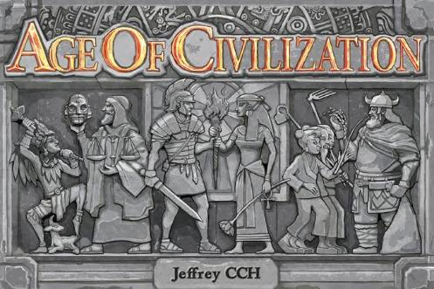

Slide 6
Causes of urbanization
Urbanization occurs as:
Individual, commercial flight
Social and government action reduce the time
Expense of commuting and transportation
Lack of improve opportunities for jobs, education, housing and transportation
Living in a city can provide:
Opportunities of proximity
Diversity
Marketplace competition
Increased cost of living

Slide 7

Urban growth and its impacts
Migration of rural people to urban areas.
Employment opportunities in urban centers.
Transport and communication facilities.
Educational facilities.
Increase in the standard of living.
Problem of over population, growth of slums etc.
Disintegration of joint family.
Cost of living.
Increase in crime rate.
Impersonal relations.

Slide 8
Causes of rural areas
Population growth and decline (counterurbanization due to urban-rural migration and rural depopulation due to rural – urban migration).
Resultant growth and decline of settlements.
Changes in the rural economy which impact society and the environment.
How will counterurbanization and rural depopulation affect a settlement?

Slide 9
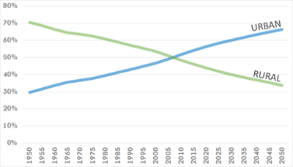
Historical global urban/rural population trends

Slide 10
Culture
What is Culture?
R.T. Schaefer
“Culture is the totality of learned socially transmitted customs, knowledge, material objects and behavior”.
(Sociology, p.53 2009)
E.B Tylor
Culture is “that complex whole which includes knowledge, belief, art, morals, law, custom, and any other capabilities and habits
acquired by man as a member if a society.”
(cited in: C. N. Shankar Rao, Sociology, p.190, 2007)
Ways of life developed by a group of people
They are detailed and minor instructions, traditions or rules for day-to-day life
Violating such kinds of norms may not result in a serious punishment unlike violating mores
Examples--dressing rules, walking, talking

Slide 11
Characteristics of culture
Culture is learnt (ex-namaskar, thanks….Cultural Eye blinking, closing eyes while sleeping…physiological)
Culture is transmassive.
Culture is continuous and cumulative
Culture is consistent and integrated
Culture is dynamic and adaptive
Culture is gratifying/rewarding
Culture varies from society to society
Culture is super organic and ideational (social meaning of national flag)

Slide 12
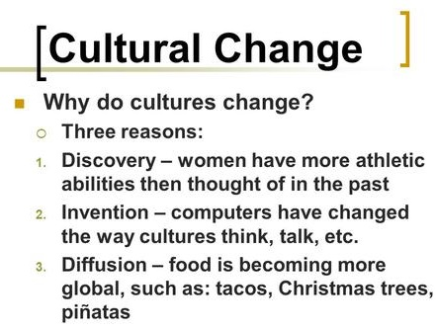

Slide 13
A Presentation on Explain importance of studying Government for the students of CSE.

Slide 14
Why Study Government?
To understand the influence government has on your daily life.
To understand why the government produces the policies it does.
To understand and interpret current events in a rapidly changing world.
To understand how the United States attempts to resolve conflicts and seeks to establish order and security.
To develop the ability to solve problems and make good decisions when current events and economic and social issues affect you directly.
To apply your understanding when voting, petitioning, and speaking publicly.

Slide 15
To deal with the government effectively in your future profession.
To prepare for a career that requires a strong knowledge of government.
To use your understanding of government to participate and bring about change in your community or country.
To contribute to the success of a democracy that depends on your understanding and active participation.

Slide 16
why Government supports the CSE?
A computer scientist should follow the democracy for their team.They should known the rule of law so that they can work with government and for government very well

Slide 17
Government and politics impacts nearly every aspect of our lives
Whether we like it or not, government plays a huge role in our daily lives, ranging from the amount of tax you pay for your morning coffee, to the types of light bulbs you’re allowed to purchase.
Since we know that government impacts various choices we make, why not take the time to understand how the process works? Who makes these laws and how do they impact me?
Having this understanding can help you determine the best course of action for yourself and your family, regarding a wide range of issues. (Most of which are more important than your coffee and light bulbs.)

Slide 18
Interaction Between the Evolution of Technology in Engineering and Society
The interaction between the evolution of technology and the development of economy and society has always been important dimension of human history. The transition from the agricultural society towards the industrial society provides the most pertinent illustration of the profound implications which the full diffusion of new technologies can have on following points :-
Family structures
Work relations
Settlement patterns
Economic power configuration
Political power configuration
Behaviour patterns
Value systems

Slide 19
What causes Sociological Change in Engineering?
Technology advancement
Economic conditions
Geo/political conditions
Cultural changes
Resource constraints

Slide 20
Theories on the Origins of Government
Evolutionary Theory
As the extended family grew in size, the elders became the governing body of that society.
Force Theory
Those who were stronger and/or had the backing of a military brought areas under their control by force and thus became the government.
Divine Right Theory
The people in some societies believed that their leaders (Kings, Emperors, etc.) were chosen by God so by obeying these leaders they were obeying God.

Slide 21
THE IMPORTANCE OF Government IN THE EDUCATION OF CSE
There have been doubts about the effectiveness and efficiency of public education.
There are doubts about the equity and accountability of public education, which particularly affect the poor.
There is an increasing awareness of initiatives by educational entrepreneurs, and evidence to suggest that competitive pressures can lead to significant educational improvements

Slide 22
Thank you

